Slide 1






Using MongoDB with .NET
Welcome to the JSON-stores world
Database
Applications
SoftUni Team
Technical Trainers
Software University
http://softuni.bg

Slide 2

Table of Contents
Connecting to MongoDb with .NET
MongoDb .NET Driver
CRUD over MongoDb with .NET
Native MongoDb Queries
LINQ Queries with MongoDb

Slide 3
Connecting to MongoDb with .NET
The C# driver for MongoDB provides a .NET SDK for working with MongoDB
Download the official MongoDb driver NuGet
Initialize a MongoClient with a connection string
Host the MongoDB instance
Connect to a database
MongoClient client = new MongoClient("mongodb://localhost");
MongoServer server = client.GetServer();
MongoDatabase db = server.GetDatabase("logger");

Slide 4


Using the MongoDB with .NET
Live Demo

Slide 5


MongoDb .NET Driver

Slide 6
The .NET MongoDB SDK
The .NET driver provides a SDK to work with MongoDB databases
Supports CRUD operations
create, read, update and delete
Can create indexes
Provides LINQ-like functionality
That is executed over the database using the native query commands
Does not have transactions
Still has atomicity on a single document

Slide 7
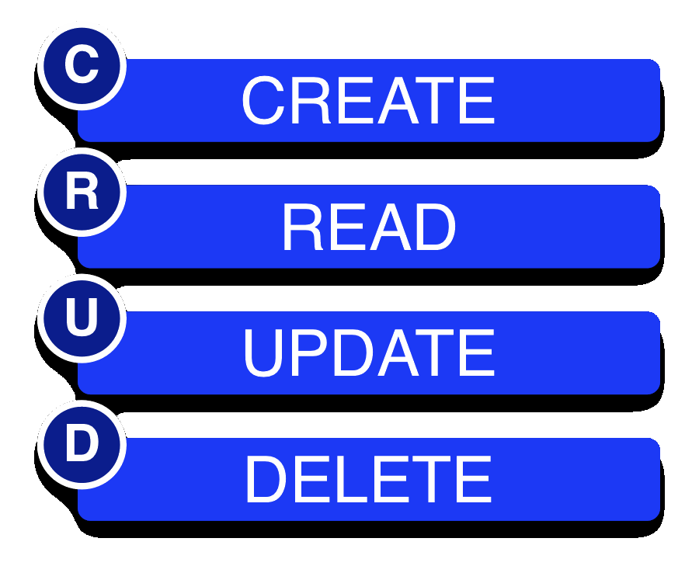
CRUD Operations with MongoDB and .NET
Insert, Remove, Update, Get

Slide 8
CRUD Over MongoDB with .NET
A collection must be created / fetched before performing any operations
All operations are done over this collection:
Fetch
Update
Insert
Remove
var logsCollection = db.GetCollection<Log>("logs");
logsCollection.FindAll();
logs.FindOneById(id);
logsCollection.Update(query, update);
logsCollection.Insert(log);
logs.Remove(removeQuery);

Slide 9


CRUD Operations with MongoDB and .NET
Live Demo

Slide 10

MongoDB Queries
Perform Operations over the Database

Slide 11
MongoDB Queries
MongoDB supports document-based queries
They are executed on the server
They are the equivalent of SQL for RDBMS
Queries can be made in two ways:
Using native-like MongoDB queries
Using LINQ-like queries

Slide 12
Native-like MongoDb Queries
Find queries are created using similar to the native MongoDB document queries
Find recent logs:
Remove logs, older than a day:
IMongoQuery findNewLogsQuery = Query.And(
Query.GT("LogDate", date));
var logs = logsCollection.Find(findNewLogsQuery);
IMongoQuery findOldLogsQuery = Query.And(
Query.LT("LogDate", Date.now.addDays(-1)));
logsCollection.Remove(findOldLogsQuery);

Slide 13
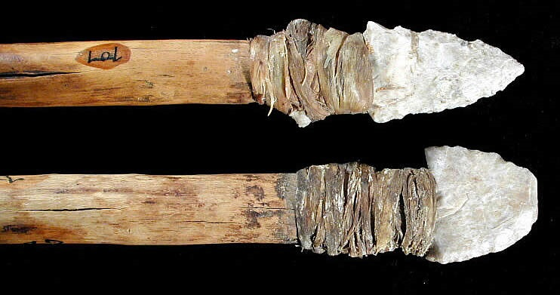
Native-like MongoDB Queries
Live Demo

Slide 14
LINQ-like Queries
var findRecentBugsQuery = Query<Log>
.Where(log => log.LogType.Type == "bug" &&
log.LogDate > date);
var logs = logsCollection.Find(findRecentBugsQuery)
.Select(log => log.Text);
logsCollection.Update();
var findOldPendwingBugsQuery = Query<Log>.Where(
log => log.LogDate < DateTime.Now.AddDays(-10) &&
log.LogType.Type == "bug" &&
log.LogType.State == "pending");

Slide 15
LINQ-like MongoDB Queries
Live Demo

Slide 16
LINQ-to-MongoDB
The MongoDB C# driver supports part of LINQ over MongoDB collections
Only LINQ queries that can be translated to an equivalent MongoDB query are supported
Others throw runtime exception and the error message will indicate which part of the query wasn’t supported
var logs =
from log in db.GetCollection<Log>("Logs").AsQueryable<Log>()
where log.LogType.Type == "ticket" &&
log.LogType.State == "pending"
select log;

Slide 17

LINQ-to-MongoDB
Live Demo

Slide 18









Using MongoDB with .NET
https://softuni.bg/courses/database-applications/

Slide 19
License
This course (slides, examples, demos, videos, homework, etc.) is licensed under the "Creative Commons Attribution-NonCommercial-ShareAlike 4.0 International" license
Attribution: this work may contain portions from
"Databases" course by Telerik Academy under CC-BY-NC-SA license

Slide 20





Free Trainings @ Software University
Software University Foundation – softuni.org
Software University – High-Quality Education, Profession and Job for Software Developers
softuni.bg
Software University @ Facebook
facebook.com/SoftwareUniversity
Software University @ YouTube
youtube.com/SoftwareUniversity
Software University Forums – forum.softuni.bg

